Slide 1

PROJECT REPORT TITLE : Fitness Club
BACHELOR OF TECHNOLOGY
Computer Science And Engineering
Submitted to
Ms. Nausheen Fatima
LOVELY PROFESSIONAL UNIVERSITY
PHAGWARA,PUNJAB

Slide 2
SUBMITTED BY: G.CHENNAKESHAVA REDDY REG NO:12205373 ROLL NO: 51 SUBMITTED BY: B.GNANESWAR REDDY REG NO:12200658 ROLL NO: 19 SUBMITTED BY: K.VIKASH REG NO:12206981 ROLL NO: 56
ACKNOWLEDGMENT
No doubt this project is only possible because of my
mentor and my Prof. Dr. Makul Mahajan sir and
We would like to thanks him from depth of our
heartfor giving us knowledge of Python and for also
giving me so many advices and various more inputs
in this project. And also We want to say thanks to
my all friends and family who gave me so many
wonderful feedbacks in this project.

Slide 3
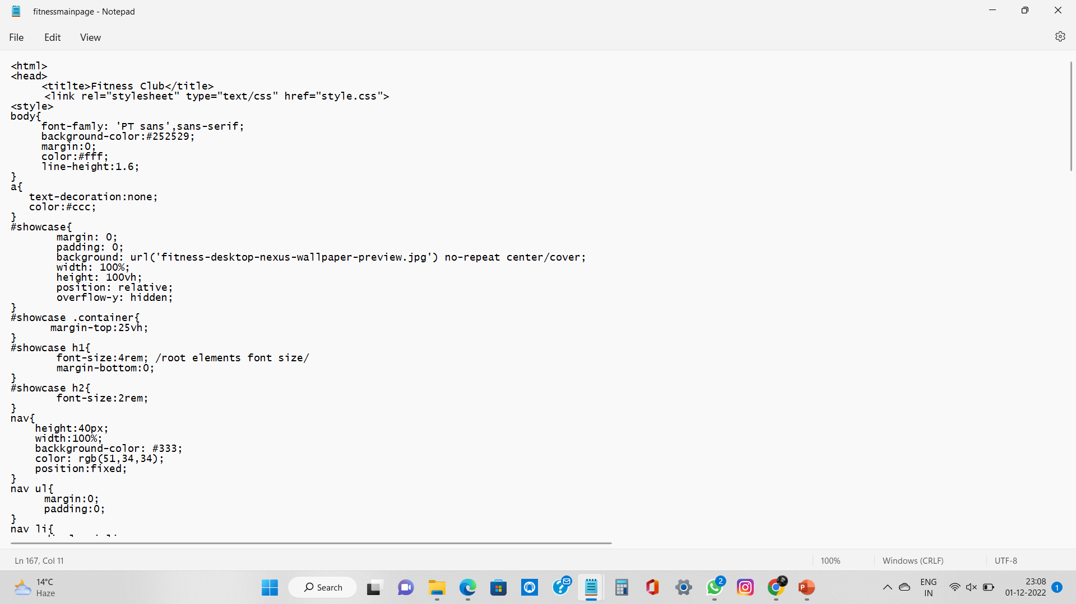
MAIN PAGE SOURCE CODE

Slide 4
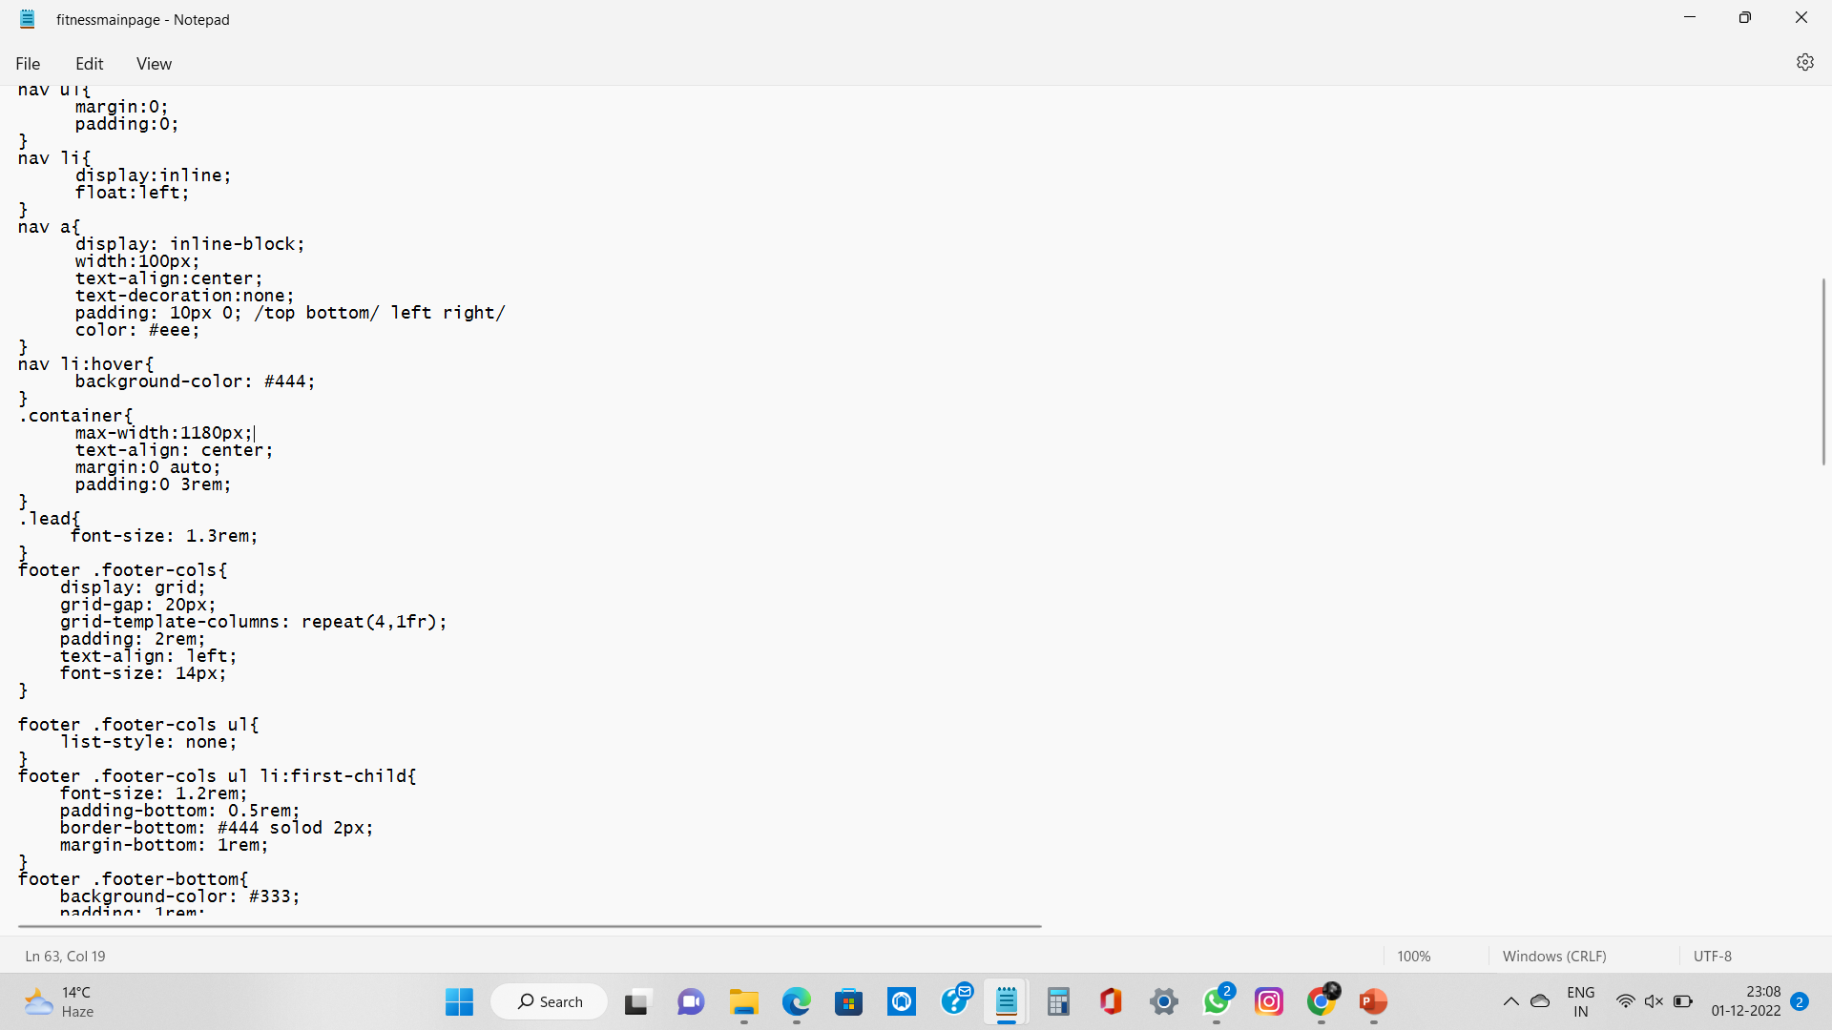

Slide 5
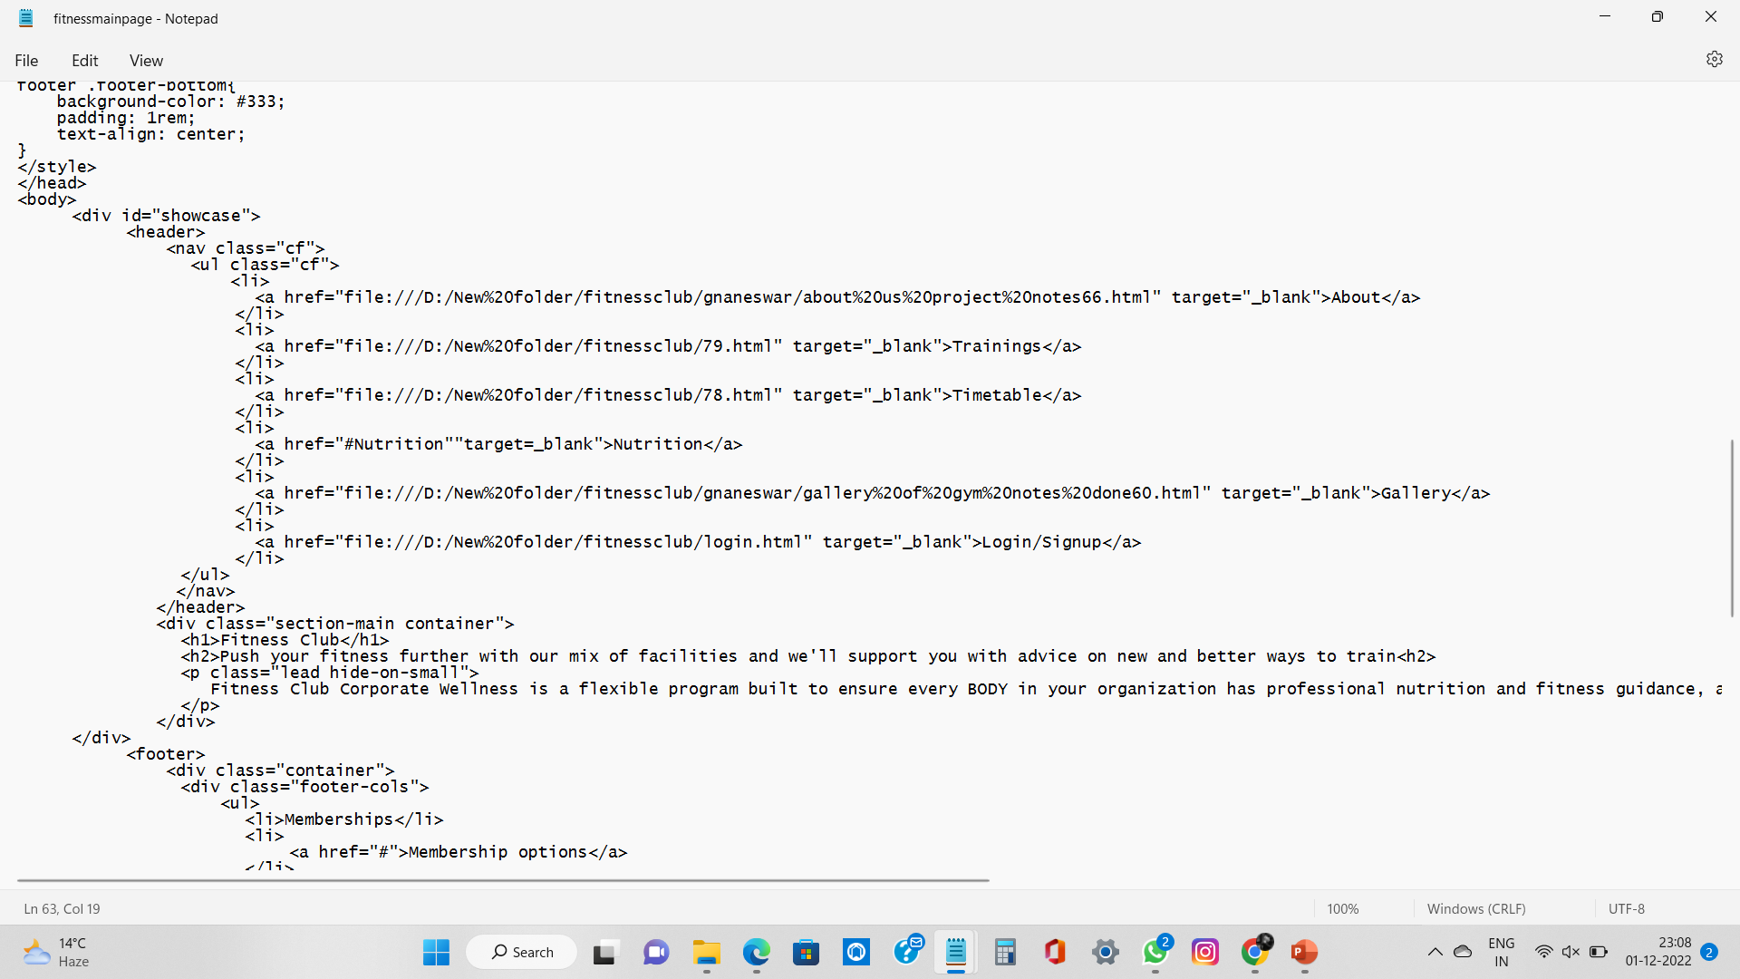

Slide 6
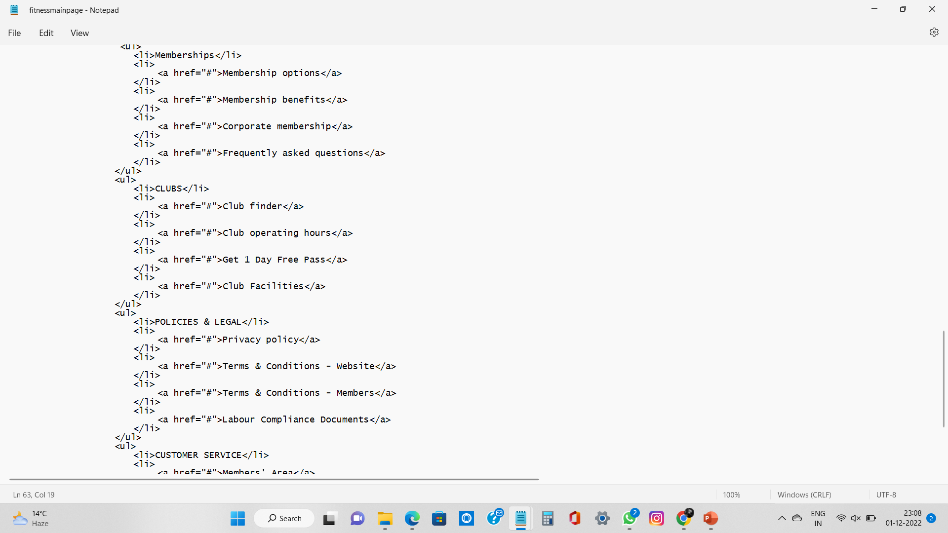

Slide 7
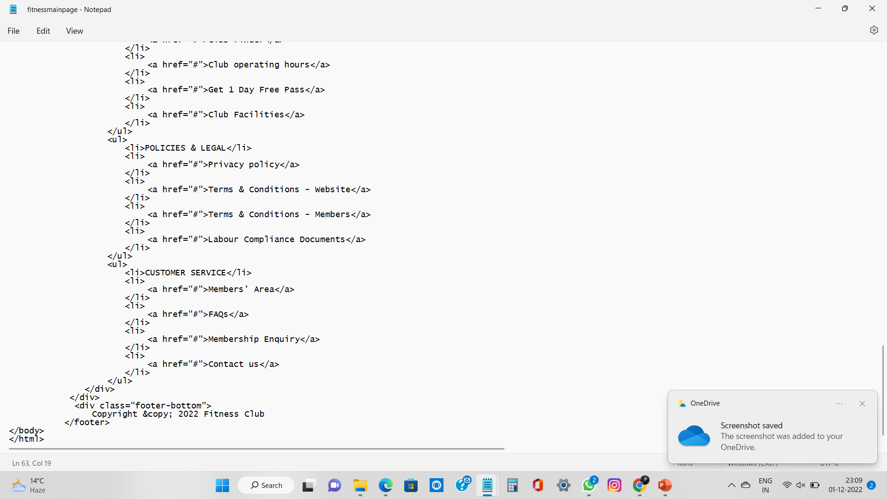

Slide 8
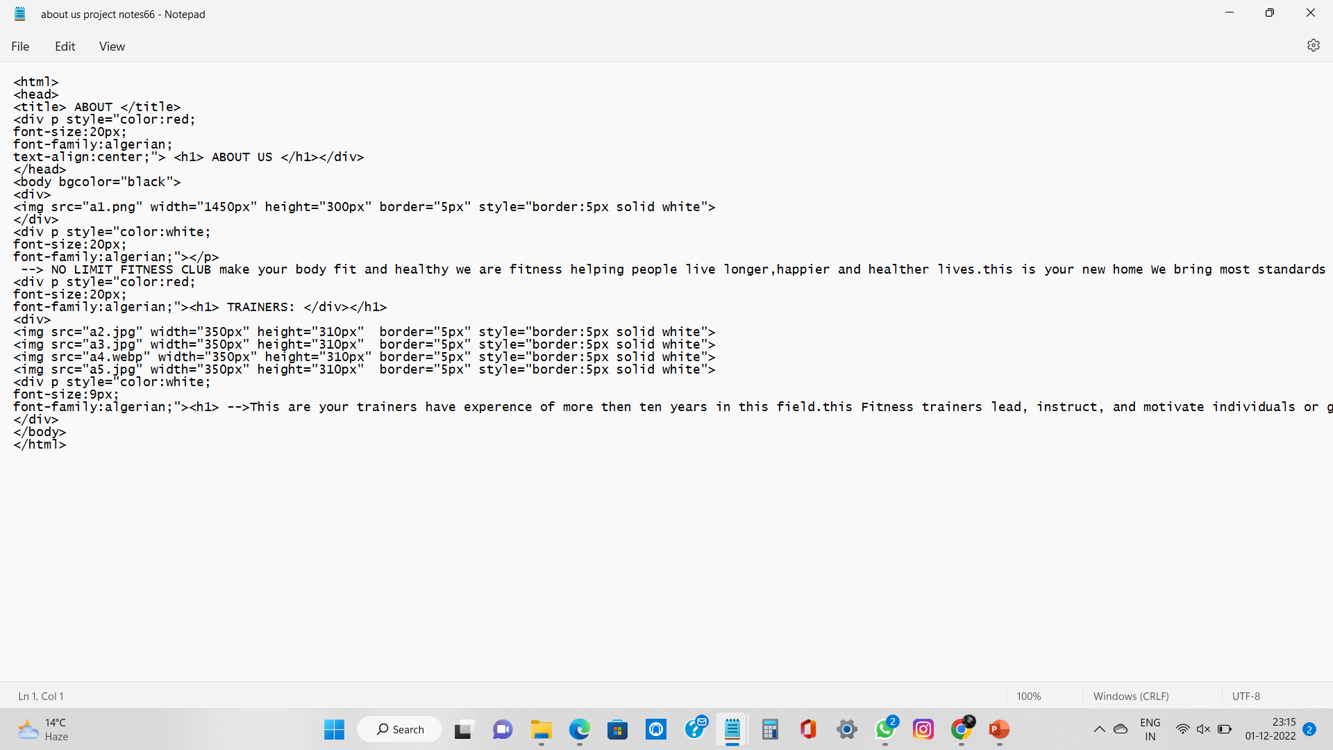
ABOUT SOURCE CODE

Slide 9
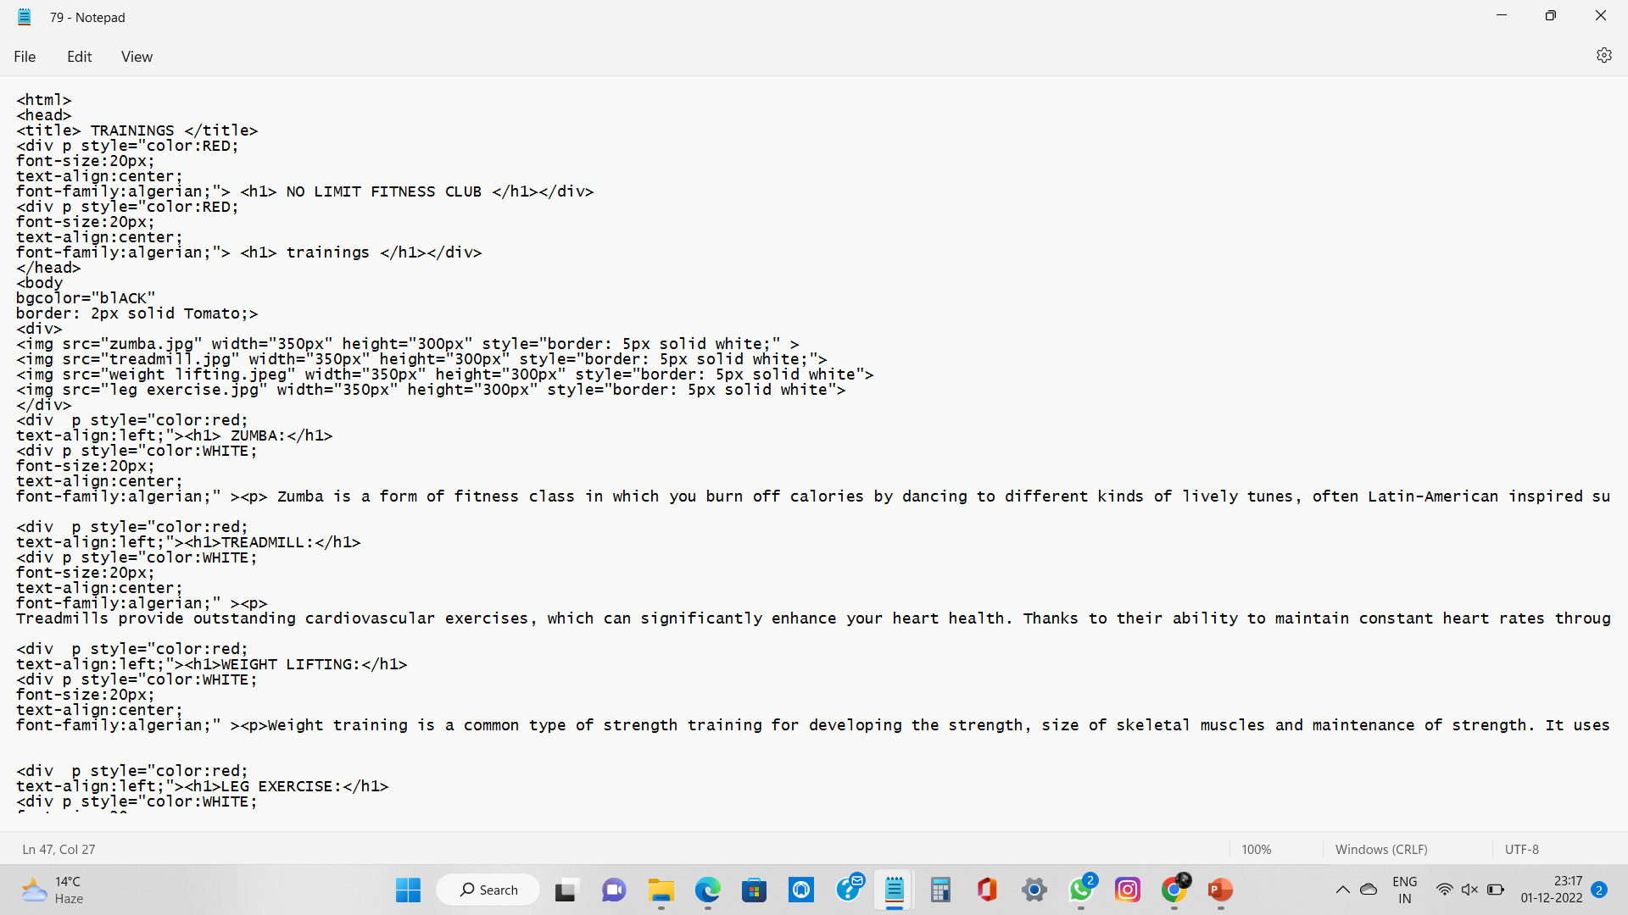
TRAINING SOURCE CODE

Slide 10
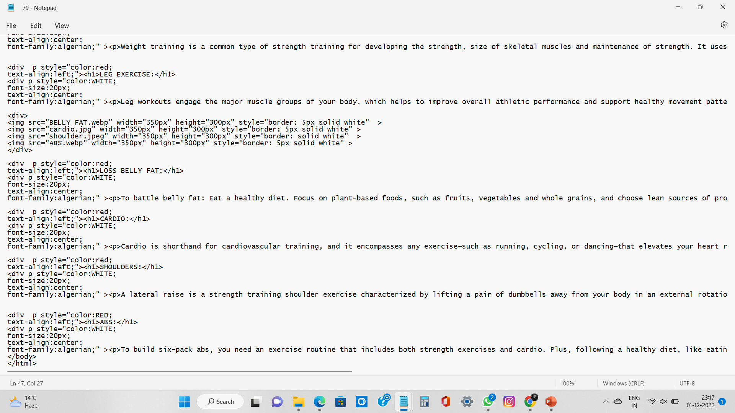

Slide 11
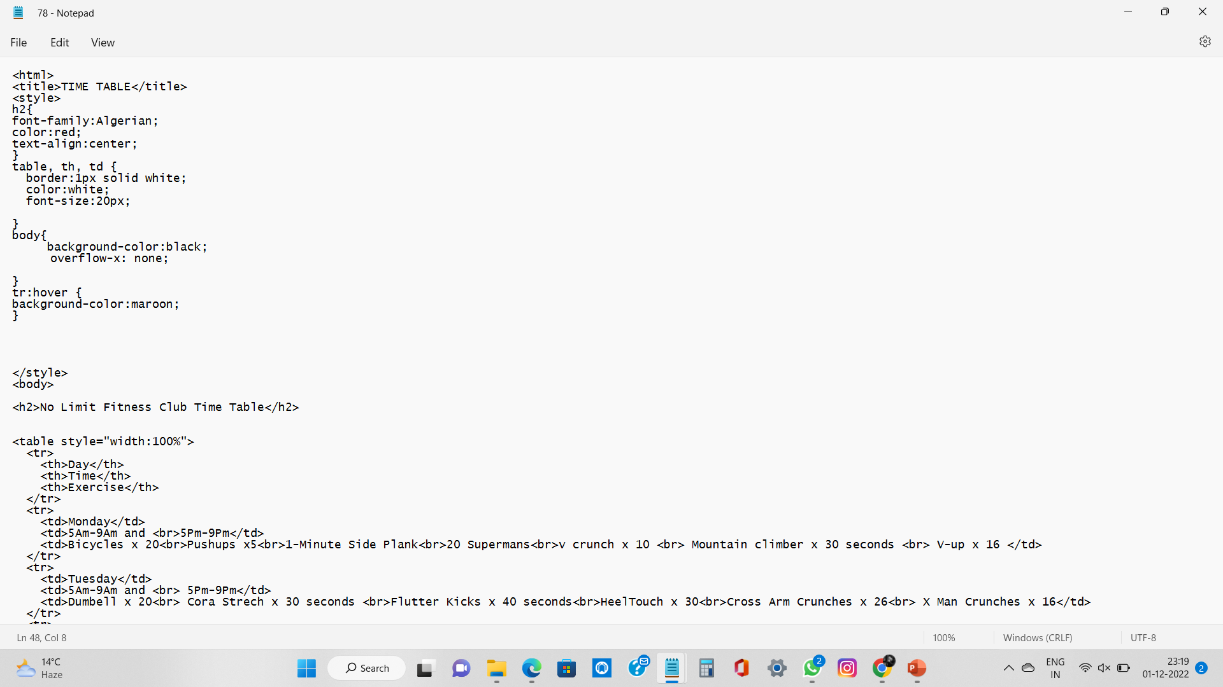
TIME TABLE SOURCE CODE

Slide 12
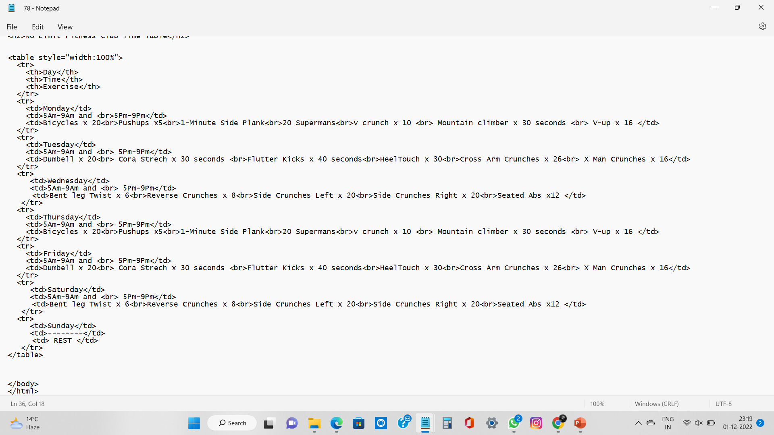

Slide 13
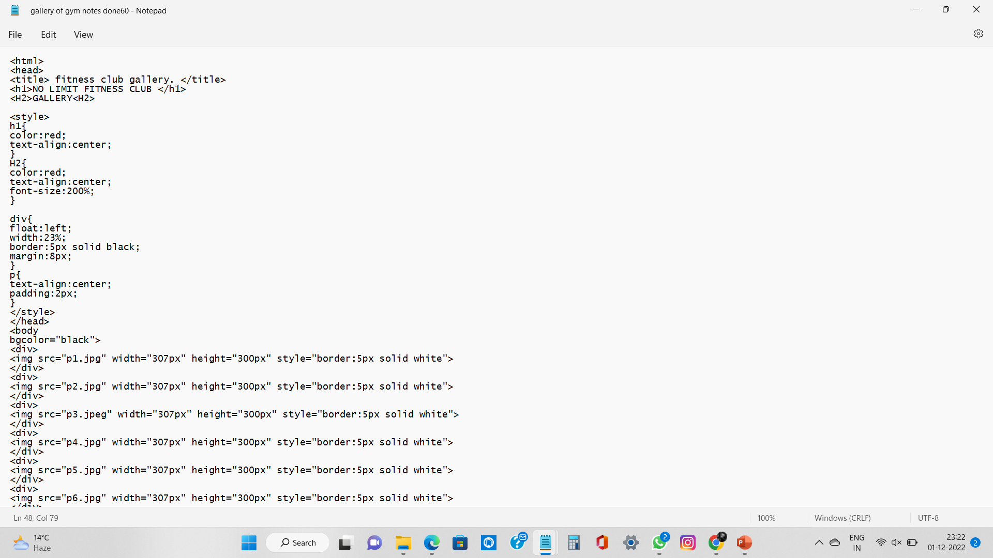
GALLERY SOURCE CODE

Slide 14
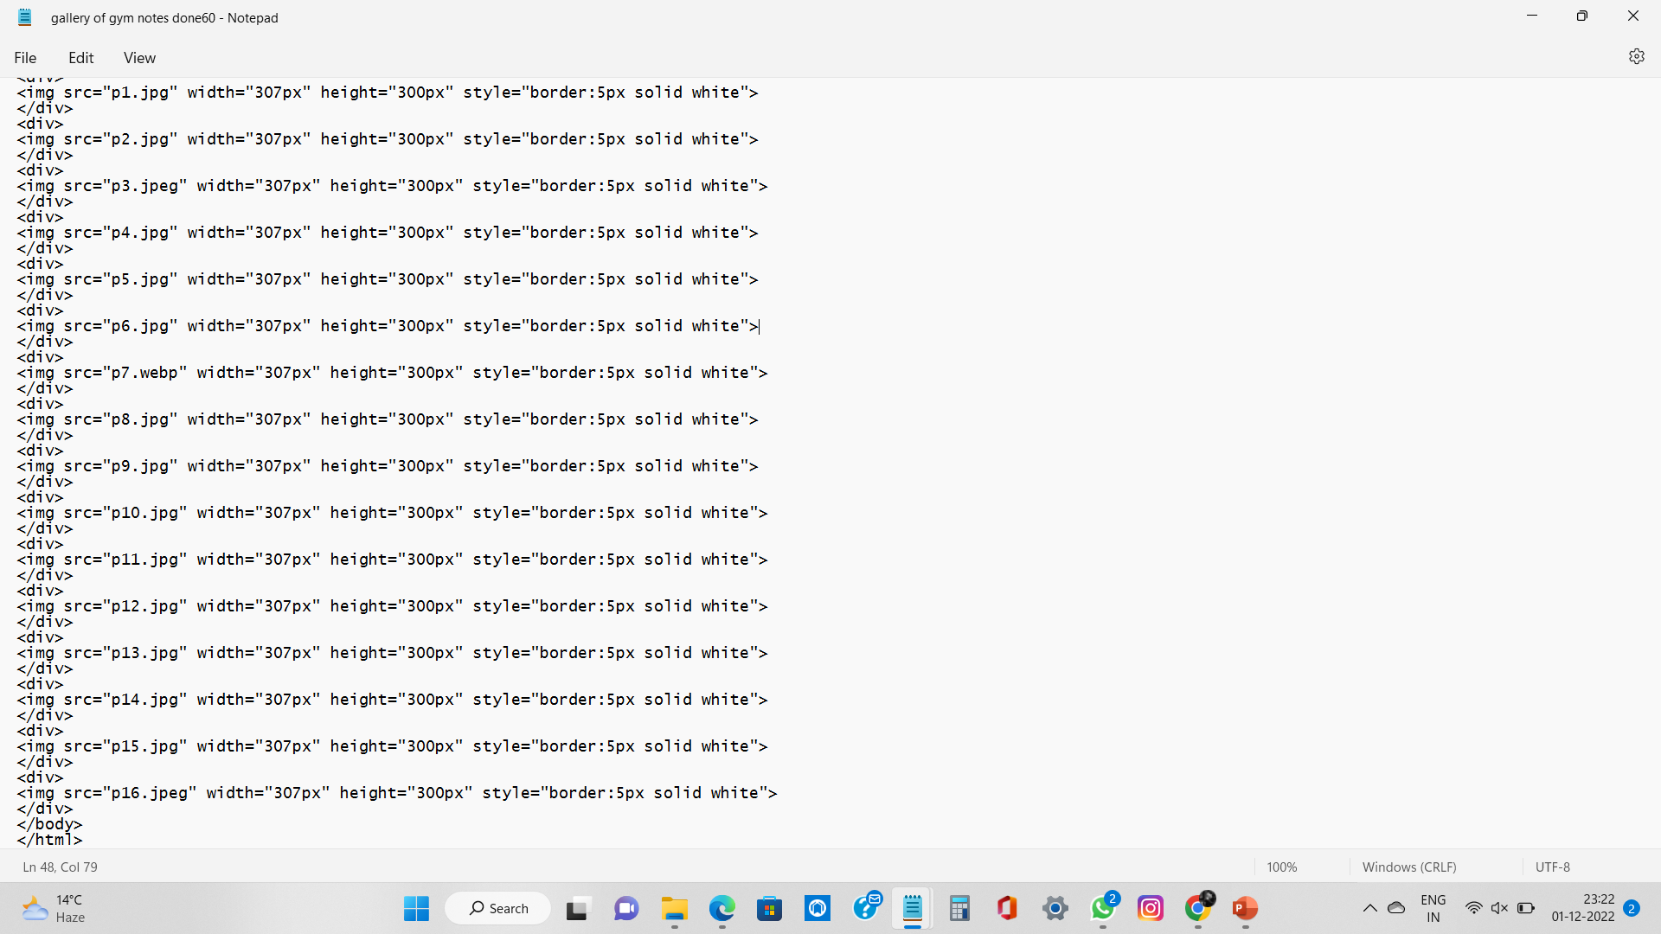

Slide 15
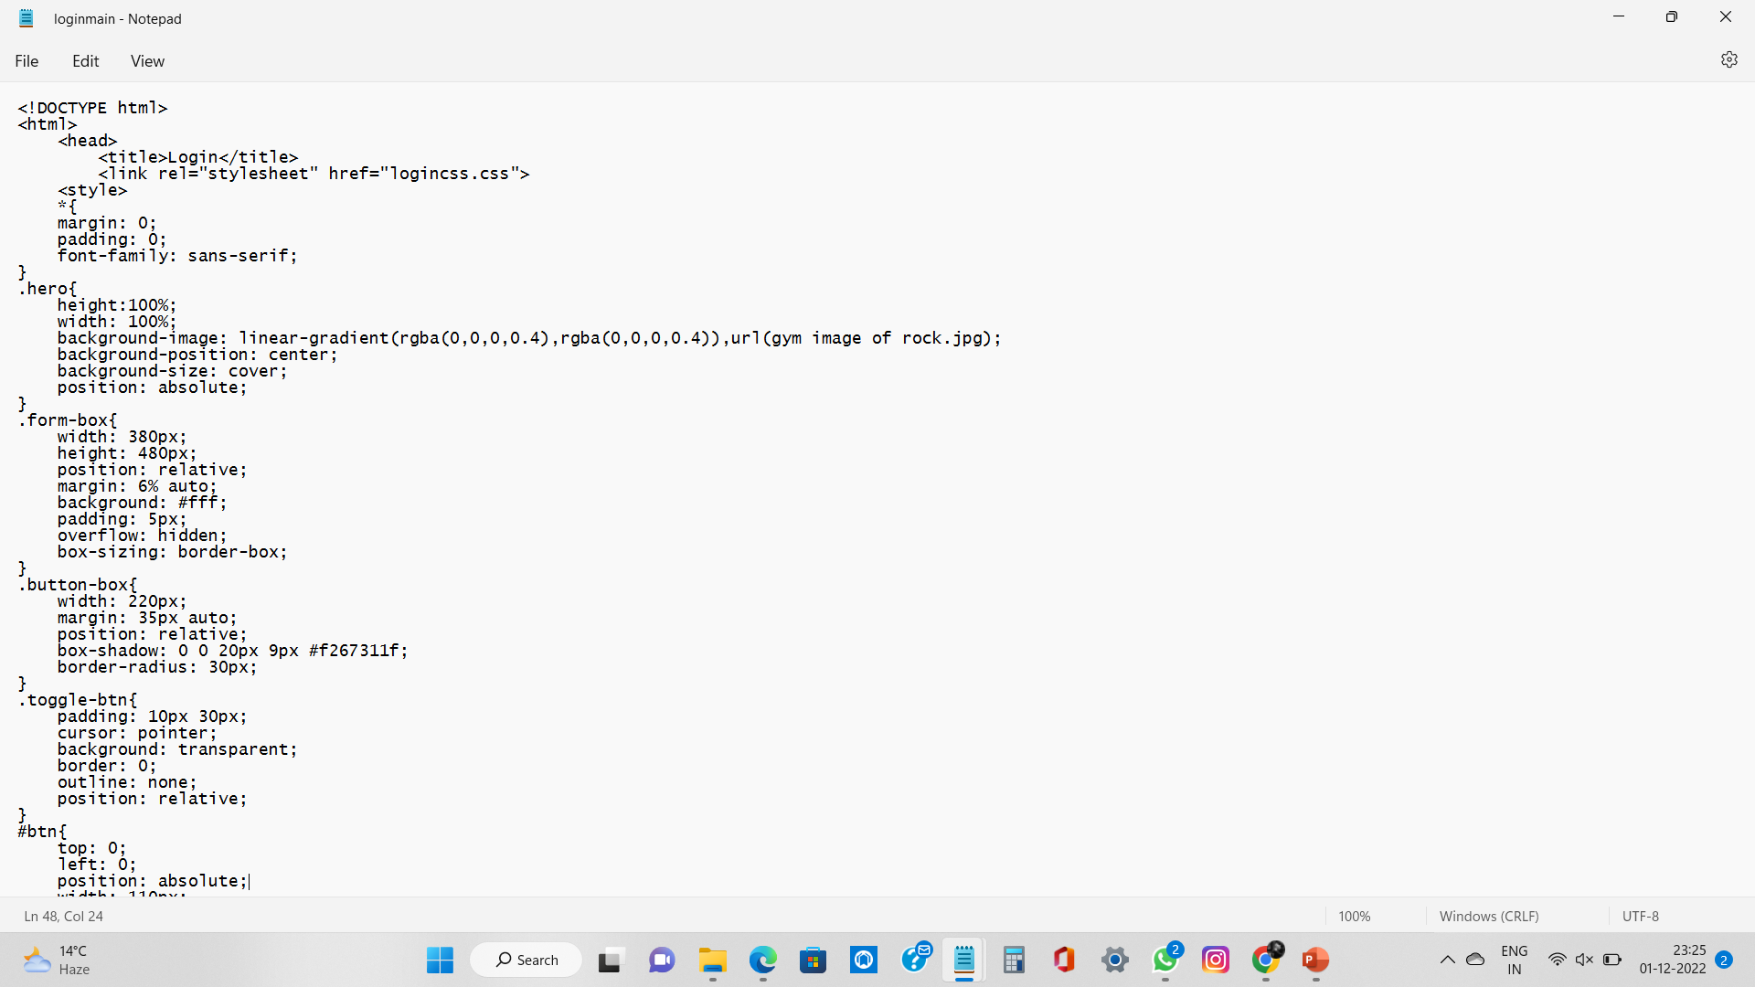
LOGIN SOURCE CODE

Slide 16
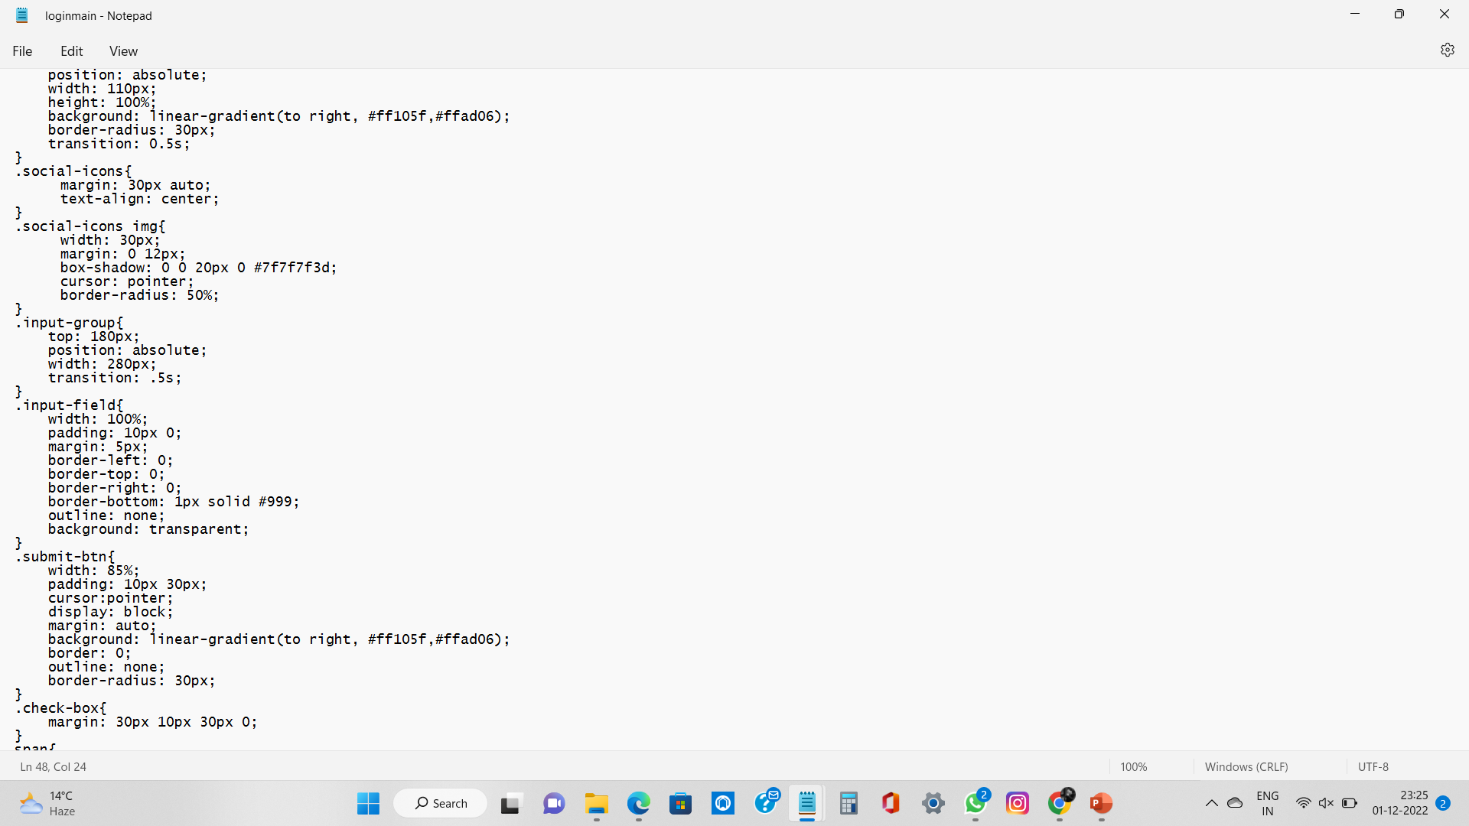

Slide 17
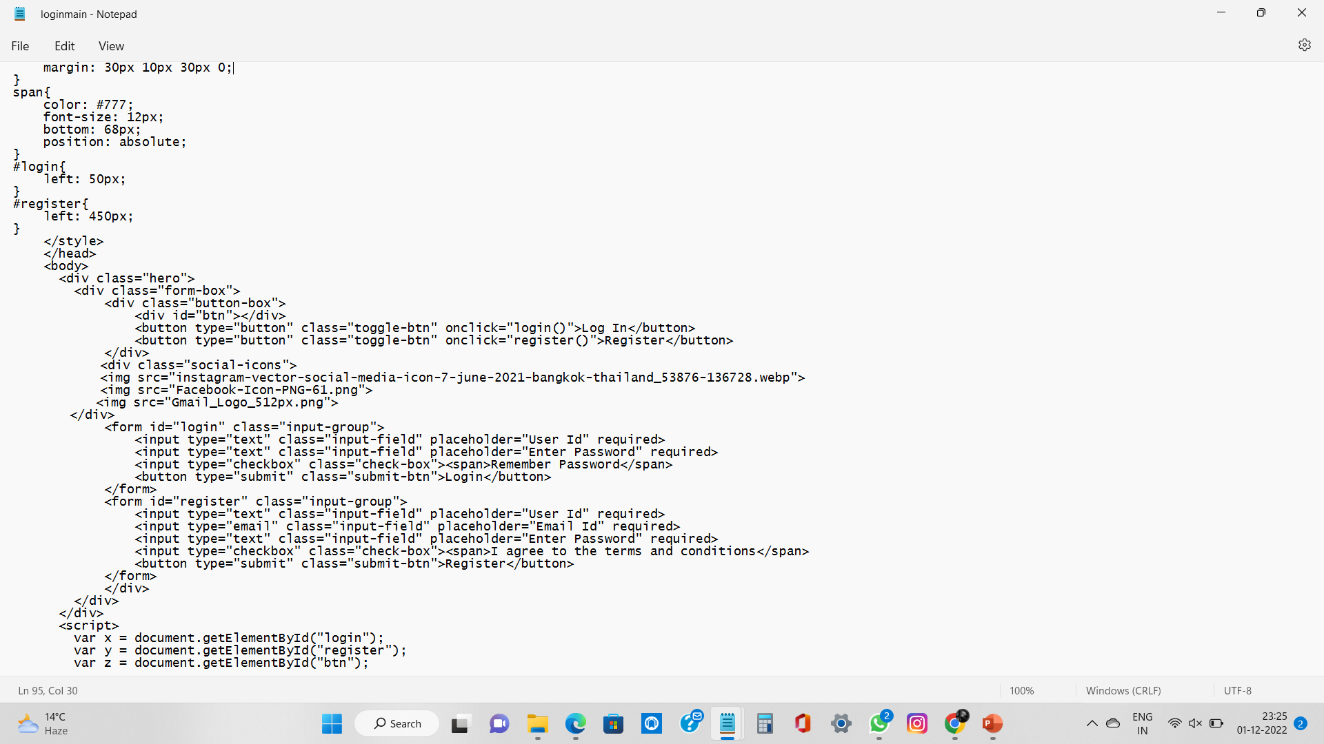

Slide 18
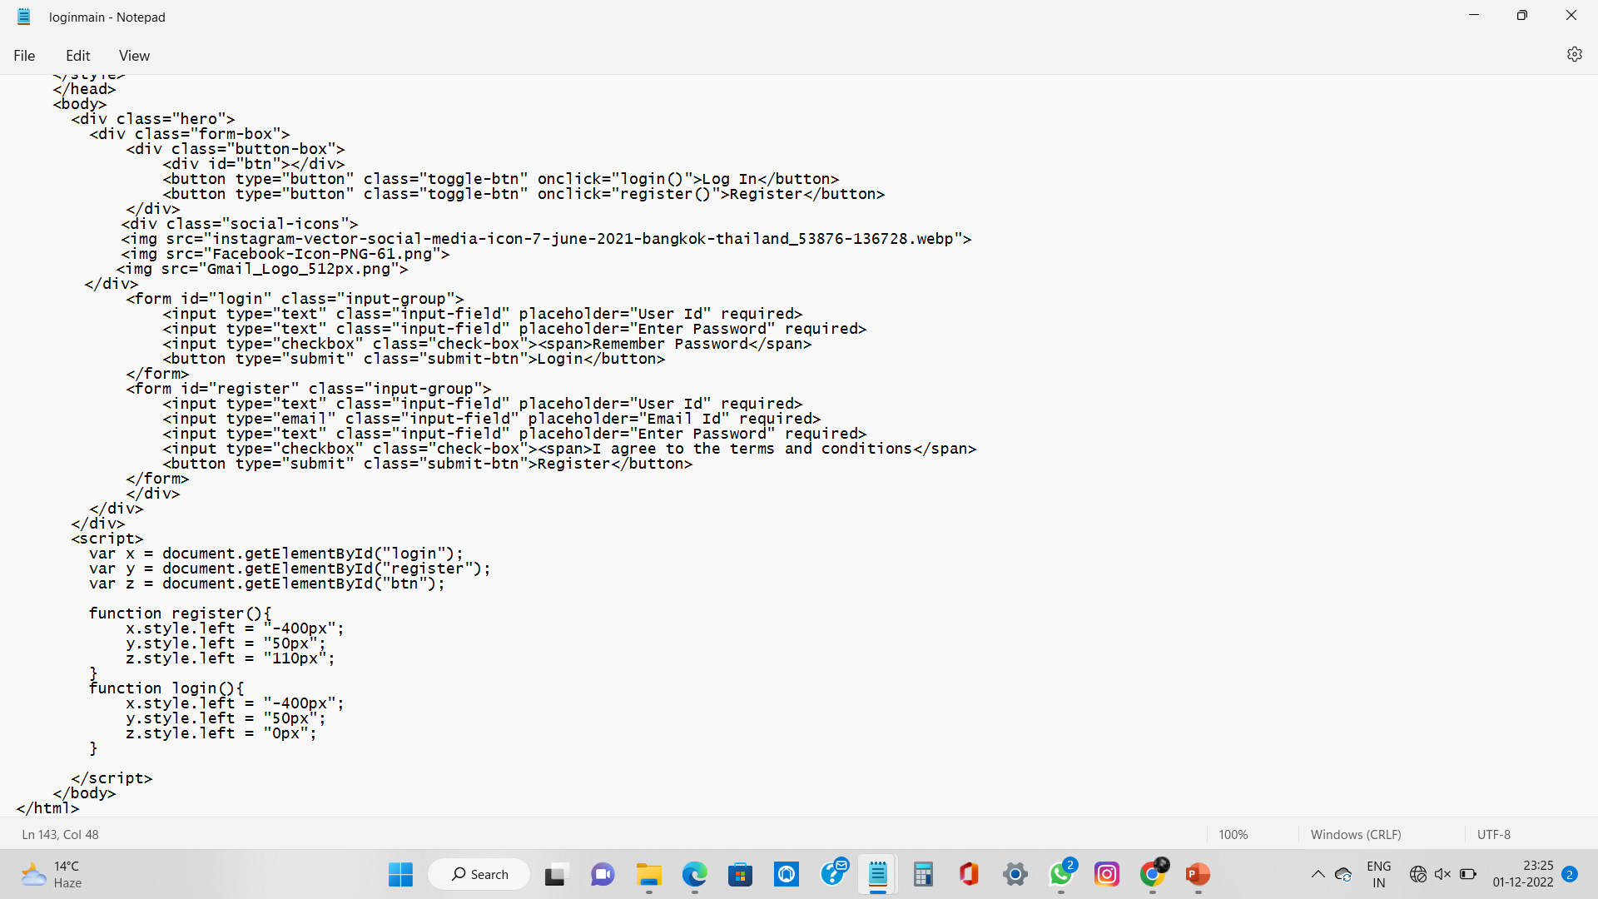

Slide 19
MAIN PAGE SOURCE CODE
<html>
<head>
<titlte>Fitness Club</title>
<link rel="stylesheet" type="text/css" href="style.css">
<style>
body{
font-famly: 'PT sans',sans-serif;
background-color:#252529;
margin:0;
color:#fff;
line-height:1.6;
}
a{
text-decoration:none;
color:#ccc;
}
#showcase{
margin: 0;
padding: 0;
background: url('fitness-desktop-nexus-wallpaper-preview.jpg') no-repeat center/cover;
width: 100%;
height: 100vh;
position: relative;
overflow-y: hidden;
}
#showcase .container{
margin-top:25vh;
}
#showcase h1{
font-size:4rem; /root elements font size/
margin-bottom:0;
}

Slide 20
}
#showcase h2{
font-size:2rem;
}
nav{
height:40px;
width:100%;
backkground-color: #333;
color: rgb(51,34,34);
position:fixed;
}
nav ul{
margin:0;
padding:0;

Slide 21
nav li{
display:inline;
float:left;
}
nav a{
display: inline-block;
width:100px;
text-align:center;
text-decoration:none;
padding: 10px 0; /top bottom/ left right/
color: #eee;
}
nav li:hover{
background-color: #444;
}
.container{
max-width:1180px;
text-align: center;
margin:0 auto;
padding:0 3rem;
}

Slide 22
.lead{
font-size: 1.3rem;
}
footer .footer-cols{
display: grid;
grid-gap: 20px;
grid-template-columns: repeat(4,1fr);
padding: 2rem;
text-align: left;
font-size: 14px;
}

Slide 23
footer .footer-cols ul{
list-style: none;
}
footer .footer-cols ul li:first-child{
font-size: 1.2rem;
padding-bottom: 0.5rem;
border-bottom: #444 solod 2px;
margin-bottom: 1rem;
}
footer .footer-bottom{
background-color: #333;
padding: 1rem;
text-align: center;
}
</style>
</head>
<body>
<div id="showcase">
<header>
<nav class="cf">
<ul class="cf">
<li>

Slide 24
<a href="#About">About</a>
</li>
<li>
<a href="#Trainings">Trainings</a>
</li>
<li>
<a href="#Timetable">Timetable</a>
</li>
<li>
<a href="#Nutrition">Nutrition</a>
</li>
<li>
<a href="#Gallery">Gallery</a>
</li>
<li>
<a href="Login/Singup">Login/Signup</a>
</li>

Slide 25
</ul>
</nav>
</header>
<div class="section-main container">
<h1>Fitness Club</h1>
<h2>Push your fitness further with our mix of facilities and we'll support you with advice on new and better ways to train<h2>
<p class="lead hide-on-small">
Fitness Club Corporate Wellness is a flexible program built to ensure every BODY in your organization has professional nutrition and fitness guidance, as well as access to premium health club facilities. Offering 19 clubs open 24/7, our locations are convenient and accessible.
</p>
</div>
</div>
<footer>
<div class="container">
<div class="footer-cols">
<ul>
<li>Memberships</li>
<li>
<a href="#">Membership options</a>
</li>
<li>
<a href="#">Membership benefits</a>

Slide 26
</li>
<li>
<a href="#">Corporate membership</a>
</li>
<li>
<a href="#">Frequently asked questions</a>

Slide 27
</li>
</ul>
<ul>
<li>CLUBS</li>
<li>
<a href="#">Club finder</a>
</li>
<li>
<a href="#">Club operating hours</a>
</li>
<li>
<a href="#">Get 1 Day Free Pass</a>
</li>
<li>
<a href="#">Club Facilities</a>
</li>
</ul>
<ul>
<li>POLICIES & LEGAL</li>
<li>
<a href="#">Privacy policy</a>
</li>
<li>
<a href="#">Terms & Conditions - Website</a>

Slide 28
</li>
<li>
<a href="#">Terms & Conditions - Members</a>
</li>
<li>
<a href="#">Labour Compliance Documents</a>
</li>
</ul>
<ul>
<li>CUSTOMER SERVICE</li>
<li>
<a href="#">Members' Area</a>
</li>
<li>
<a href="#">FAQs</a>
</li>
<li>
<a href="#">Membership Enquiry</a>
</li>
<li>
<a href="#">Contact us</a>
</li>
</ul>
</div>
</div>

Slide 29
<div class="footer-bottom">
Copyright &copy; 2022 Fitness Club
</footer>
</body>
</html>

Slide 30
ABOUT SOURCE CODE
<html>
<head>
<title> ABOUT </title>
<div p style="color:red;
font-size:20px;
font-family:algerian;
text-align:center;"> <h1> ABOUT US </h1></div>
</head>
<body bgcolor="black">
<div>
<img src="a1.png" width="1450px" height="300px" border="5px" style="border:5px solid white">
</div>
<div p style="color:white;
font-size:20px;
font-family:algerian;"></p>
--> NO LIMIT FITNESS CLUB make your body fit and healthy we are fitness helping people live longer,happier and healther lives.this is your new home We bring most standards of gym equiment for giving you most out of each exercise Our specialists are very prepared and fit they will take care of your healthy that will push you as far as possible without any problem no limit fitness club was established in 2015 Co-structured with BSF Design Group no limit fitness club Former displays an extraordinary crossbreed of seat and reformer Pilates techniques, mixing quality preparing and cardio for a full-body exercise You’ll get a great vibe decent simply like from the sun’s characteristic beams in addition to IR has been appeared to help with cell fix, flow, detoxification, and stress decrease. IR warm is the following stage in exercise advancement and there will be great vibe and good atmosphere to do gym ....</div>
<div p style="color:red;
font-size:20px;
font-family:algerian;"><h1> TRAINERS: </div></h1>
<div>
<img src="a2.jpg" width="350px" height="310px" border="5px" style="border:5px solid white">
<img src="a3.jpg" width="350px" height="310px" border="5px" style="border:5px solid white">
<img src="a4.webp" width="350px" height="310px" border="5px" style="border:5px solid white">
<img src="a5.jpg" width="350px" height="310px" border="5px" style="border:5px solid white">
<div p style="color:white;
font-size:9px;
font-family:algerian;"><h1> -->This are your trainers have experence of more then ten years in this field.this Fitness trainers lead, instruct, and motivate individuals or groups in exercise activities, including cardiovascular exercises (exercises for the heart and blood circulation), strength training, and stretching. They work with people of all ages and skill levels. </div></h1>
</div>
</body>
</html>

Slide 31
TRAINING SOURCE CODE
<html>
<head>
<title> ABOUT </title>
<div p style="color:RED;
font-size:20px;
text-align:center;
font-family:algerian;"> <h1> NO LIMIT FITNESS CLUB </h1></div>
<div p style="color:RED;
font-size:20px;
text-align:center;
font-family:algerian;"> <h1> trainings </h1></div>
</head>
<body
bgcolor="blACK"
border: 2px solid Tomato;>
<div>
<img src="zumba.jpg" width="350px" height="300px" style="border: 5px solid white;" >
<img src="treadmill.jpg" width="350px" height="300px" style="border: 5px solid white;">
<img src="weight lifting.jpeg" width="350px" height="300px" style="border: 5px solid white">
<img src="leg exercise.jpg" width="350px" height="300px" style="border: 5px solid white">
</div>
<div p style="color:red;
text-align:left;"><h1> ZUMBA:</h1>
<div p style="color:WHITE;
font-size:20px;
text-align:center;
font-family:algerian;" ><p> Zumba is a form of fitness class in which you burn off calories by dancing to different kinds of lively tunes, often Latin-American inspired such as salsa, merengue and samba, but also other types of modern music like hip hop and Bollywood music from the Indian film industry.</div></p>
<div p style="color:red;
text-align:left;"><h1>TREADMILL:</h1>
<div p style="color:WHITE;

Slide 32
font-size:20px;
text-align:center;
font-family:algerian;" ><p>
Treadmills provide outstanding cardiovascular exercises, which can significantly enhance your heart health. Thanks to their ability to maintain constant heart rates throughout the exercise. If you've high cholesterol or cardiovascular issues, this can be very beneficial.</div></p>
<div p style="color:red;
text-align:left;"><h1>WEIGHT LIFTING:</h1>
<div p style="color:WHITE;
font-size:20px;
text-align:center;
font-family:algerian;" ><p>Weight training is a common type of strength training for developing the strength, size of skeletal muscles and maintenance of strength. It uses the force of gravity in the form of weighted bars, dumbbells or weight stacks in order to oppose the force generated by muscle through concentric or eccentric contraction.</div></p>
<div p style="color:red;
text-align:left;"><h1>LEG EXERCISE:</h1>
<div p style="color:WHITE;
font-size:20px;
text-align:center;
font-family:algerian;" ><p>Leg workouts engage the major muscle groups of your body, which helps to improve overall athletic performance and support healthy movement patterns in your daily life. A strong lower body will also help to prevent injury and manage chronic conditions such as arthritis, heart disease, and diabetes.</div></p>
<div>
<img src="BELLY FAT.webp" width="350px" height="300px" style="border: 5px solid white" >
<img src="cardio.jpg" width="350px" height="300px" style="border: 5px solid white" >
<img src="shoulder.jpeg" width="350px" height="300px" style="border: solid white" >
<img src="ABS.webp" width="350px" height="300px" style="border: 5px solid white" >
</div>
<div p style="color:red;
text-align:left;"><h1>LOSS BELLY FAT:</h1>
<div p style="color:WHITE;
font-size:20px;

Slide 33
text-align:center;
font-family:algerian;" ><p>To battle belly fat: Eat a healthy diet. Focus on plant-based foods, such as fruits, vegetables and whole grains, and choose lean sources of protein and low-fat dairy products. Limit added sugar and saturated fat, which is found in meat and high-fat dairy products, such as cheese and butter.</div></p>
<div p style="color:red;
text-align:left;"><h1>CARDIO:</h1>
<div p style="color:WHITE;
font-size:20px;
text-align:center;
font-family:algerian;" ><p>Cardio is shorthand for cardiovascular training, and it encompasses any exercise—such as running, cycling, or dancing—that elevates your heart rate. Cardio is also considered aerobic exercise, meaning it demands elevated oxygen flow, which causes you to breathe harder.</div></p>
<div p style="color:red;
text-align:left;"><h1>SHOULDERS:</h1>
<div p style="color:WHITE;
font-size:20px;
text-align:center;
font-family:algerian;" ><p>A lateral raise is a strength training shoulder exercise characterized by lifting a pair of dumbbells away from your body in an external rotation. Lateral raises work the trapezius muscle in your upper back as well as the deltoid muscle group in your shoulders—particularly the anterior and lateral deltoids.</div></p>
<div p style="color:RED;
text-align:left;"><h1>ABS:</h1>
<div p style="color:WHITE;
font-size:20px;
text-align:center;
font-family:algerian;" ><p>To build six-pack abs, you need an exercise routine that includes both strength exercises and cardio. Plus, following a healthy diet, like eating more lean protein, whole grains, and vegetables can help you reach your six-pack goals.</div></p>
</body>
</html>N

Slide 34
TIME TABLE SOURCE CODE
<html>
<style>
h2{
font-family:Algerian;
color:red;
text-align:center;
}
table, th, td {
border:1px solid white;
color:white;
font-size:20px;
}
body{
background-color:black;
overflow-x: none;
}
tr:hover {
background-color:maroon;
}
</style>
<body>
<h2>No Limit Fitness Club Time Table</h2>

Slide 35
<table style="width:100%">
<tr>
<th>Day</th>
<th>Time</th>
<th>Exercise</th>
</tr>
<tr>
<td>Monday</td>
<td>5Am-9Am and <br>5Pm-9Pm</td>
<td>Bicycles x 20<br>Pushups x5<br>1-Minute Side Plank<br>20 Supermans<br>v crunch x 10 <br> Mountain climber x 30 seconds <br> V-up x 16 </td>
</tr>
<tr>
<td>Tuesday</td>
<td>5Am-9Am and <br> 5Pm-9Pm</td>
<td>Dumbell x 20<br> Cora Strech x 30 seconds <br>Flutter Kicks x 40 seconds<br>HeelTouch x 30<br>Cross Arm Crunches x 26<br> X Man Crunches x 16</td>
</tr>
<tr>
<td>Wednesday</td>
<td>5Am-9Am and <br> 5Pm-9Pm</td>
<td>Bent leg Twist x 6<br>Reverse Crunches x 8<br>Side Crunches Left x 20<br>Side Crunches Right x 20<br>Seated Abs x12 </td>
</tr>
<tr>
<td>Thursday</td>
<td>5Am-9Am and <br> 5Pm-9Pm</td>
<td>Bicycles x 20<br>Pushups x5<br>1-Minute Side Plank<br>20 Supermans<br>v crunch x 10 <br> Mountain climber x 30 seconds <br> V-up x 16 </td>
</tr>
<tr>
<td>Friday</td>
<td>5Am-9Am and <br> 5Pm-9Pm</td>
<td>Dumbell x 20<br> Cora Strech x 30 seconds <br>Flutter Kicks x 40 seconds<br>HeelTouch x 30<br>Cross Arm Crunches x 26<br> X Man Crunches x 16</td>
</tr>
<tr>

Slide 36
<td>Saturday</td>
<td>5Am-9Am and <br> 5Pm-9Pm</td>
<td>Bent leg Twist x 6<br>Reverse Crunches x 8<br>Side Crunches Left x 20<br>Side Crunches Right x 20<br>Seated Abs x12 </td>
</tr>
<tr>
<td>Sunday</td>
<td>--------</td>
<td> REST </td>
</tr>
</table>
</body>
</html>

Slide 37
GALLERY SOURCE CODE
<html>
<head>
<title> fitness club gallery. </title>
<h1>NO LIMIT FITNESS CLUB </h1>
<H2>GALLERY<H2>
<style>
h1{
color:red;
text-align:center;
}
H2{
color:red;
text-align:center;
font-size:200%;
}
div{
float:left;
width:23%;
border:5px solid black;
margin:8px;
}
p{
text-align:center;
padding:2px;
}
</style>
</head>
<body
bgcolor="black">

Slide 38
<div>
<img src="p1.jpg" width="307px" height="300px" style="border:5px solid white">
</div>
<div>
<img src="p2.jpg" width="307px" height="300px" style="border:5px solid white">
</div>
<div>
<img src="p3.jpeg" width="307px" height="300px" style="border:5px solid white">
</div>
<div>
<img src="p4.jpg" width="307px" height="300px" style="border:5px solid white">
</div>
<div>
<img src="p5.jpg" width="307px" height="300px" style="border:5px solid white">
</div>
<div>
<img src="p6.jpg" width="307px" height="300px" style="border:5px solid white">
</div>
<div>
<img src="p7.webp" width="307px" height="300px" style="border:5px solid white">
</div>
<div>
<img src="p8.jpg" width="307px" height="300px" style="border:5px solid white">
</div>
<div>
<img src="p9.jpg" width="307px" height="300px" style="border:5px solid white">
</div>
<div>
<img src="p10.jpg" width="307px" height="300px" style="border:5px solid white">
</div>
<div>

Slide 39
<img src="p11.jpg" width="307px" height="300px" style="border:5px solid white">
</div>
<div>
<img src="p12.jpg" width="307px" height="300px" style="border:5px solid white">
</div>
<div>
<img src="p13.jpg" width="307px" height="300px" style="border:5px solid white">
</div>
<div>
<img src="p14.jpg" width="307px" height="300px" style="border:5px solid white">
</div>
<div>
<img src="p15.jpg" width="307px" height="300px" style="border:5px solid white">
</div>
<div>
<img src="p16.jpeg" width="307px" height="300px" style="border:5px solid white">
</div>
</body>
</html>

Slide 40
LOGIN/SIGNUP SOURCE CODE
<!DOCTYPE html>
<html>
<head>
<title>Login</title>
<link rel="stylesheet" href="logincss.css">
<style>
*{
margin: 0;
padding: 0;
font-family: sans-serif;
}
.hero{
height:100%;
width: 100%;
background-image: linear-gradient(rgba(0,0,0,0.4),rgba(0,0,0,0.4)),url(images/loginbackground.jpg);
background-position: center;
background-size: cover;
position: absolute;
}
.form-box{
width: 380px;
height: 480px;
position: relative;
margin: 6% auto;
background: #fff;
padding: 5px;
overflow: hidden;
box-sizing: border-box;
}
.button-box{
width: 220px;

Slide 41
margin: 35px auto;
position: relative;
box-shadow: 0 0 20px 9px #f267311f;
border-radius: 30px;
}
.toggle-btn{
padding: 10px 30px;
cursor: pointer;
background: transparent;
border: 0;
outline: none;
position: relative;
}
#btn{
top: 0;
left: 0;
position: absolute;
width: 110px;
height: 100%;
background: linear-gradient(to right, #ff105f,#ffad06);
border-radius: 30px;
transition: 0.5s;
}
.social-icons{
margin: 30px auto;
text-align: center;
}
.social-icons img{
width: 30px;
margin: 0 12px;
box-shadow: 0 0 20px 0 #7f7f7f3d;
cursor: pointer;

Slide 42
border-radius: 50%;
}
.input-group{
top: 180px;
position: absolute;
width: 280px;
transition: .5s;
}
.input-field{
width: 100%;
padding: 10px 0;
margin: 5px;
border-left: 0;
border-top: 0;
border-right: 0;
border-bottom: 1px solid #999;
outline: none;
background: transparent;
}
.submit-btn{
width: 85%;
padding: 10px 30px;
cursor:pointer;
display: block;
margin: auto;
background: linear-gradient(to right, #ff105f,#ffad06);
border: 0;
outline: none;
border-radius: 30px;
}
.check-box{

Slide 43
margin: 30px 10px 30px 0;
}
span{
color: #777;
font-size: 12px;
bottom: 68px;
position: absolute;
}
#login{
left: 50px;
}
#register{
left: 450px;
}
</style>
</head>
<body>
<div class="hero">
<div class="form-box">
<div class="button-box">
<div id="btn"></div>
<button type="button" class="toggle-btn" onclick="login()">Log In</button>
<button type="button" class="toggle-btn" onclick="register()">Register</button>
</div>
<div class="social-icons">
<img src="instagram-vector-social-media-icon-7-june-2021-bangkok-thailand_53876-136728.webp">
<img src="Facebook-Icon-PNG-61.png">
<img src="Gmail_Logo_512px.png">
</div>
<form id="login" class="input-group">

Slide 44
<input type="text" class="input-field" placeholder="User Id" required>
<input type="text" class="input-field" placeholder="Enter Password" required>
<input type="checkbox" class="check-box"><span>Remember Password</span>
<button type="submit" class="submit-btn">Login</button>
</form>
<form id="register" class="input-group">
<input type="text" class="input-field" placeholder="User Id" required>
<input type="email" class="input-field" placeholder="Email Id" required>
<input type="text" class="input-field" placeholder="Enter Password" required>
<input type="checkbox" class="check-box"><span>I agree to the terms and conditions</span>
<button type="submit" class="submit-btn">Register</button>
</form>
</div>
</div>
</div>
<script>
var x = document.getElementById("login");
var y = document.getElementById("register");
var z = document.getElementById("btn");
function register(){
x.style.left = "-400px";
y.style.left = "50px";
z.style.left = "110px";
}
function login(){
x.style.left = "-400px";
y.style.left = "50px";
z.style.left = "0px";
}

Slide 45
</script>
</body>
</html>

Slide 46
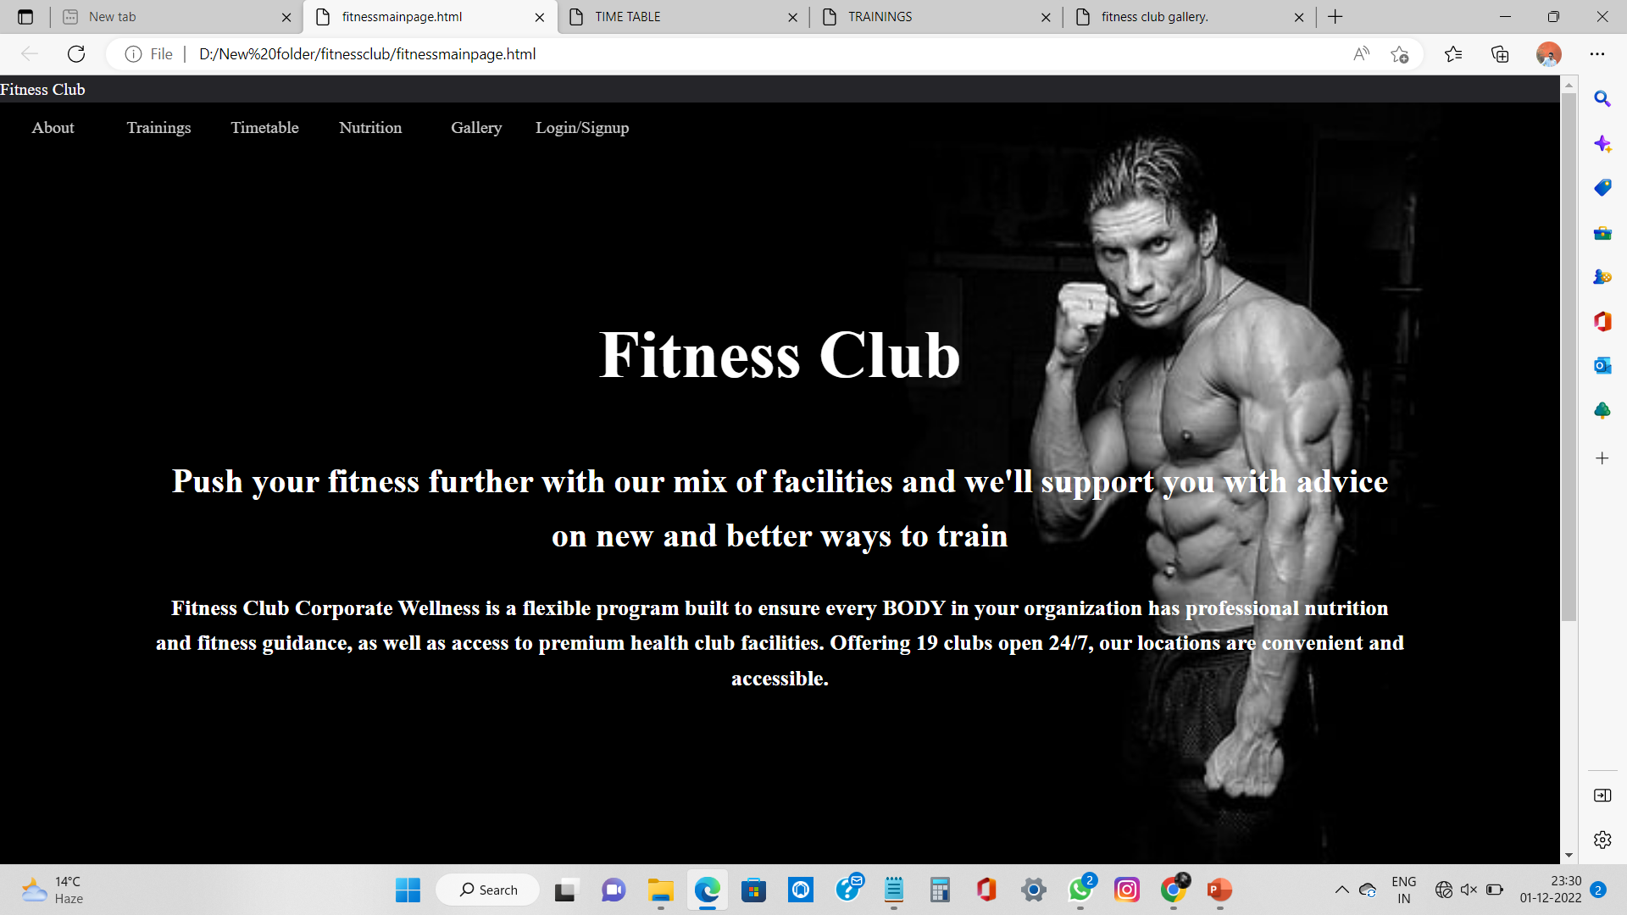
MAIN PAGE OUTPUT

Slide 47
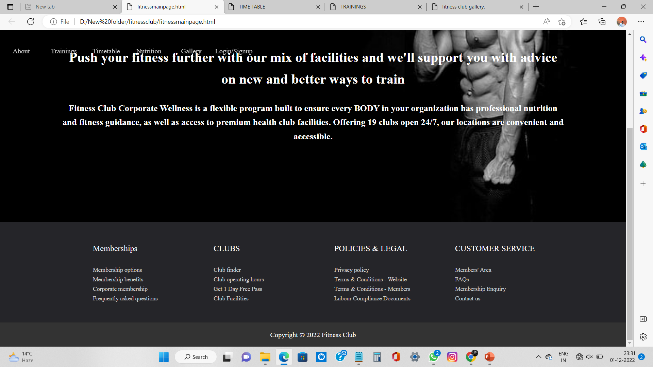

Slide 48
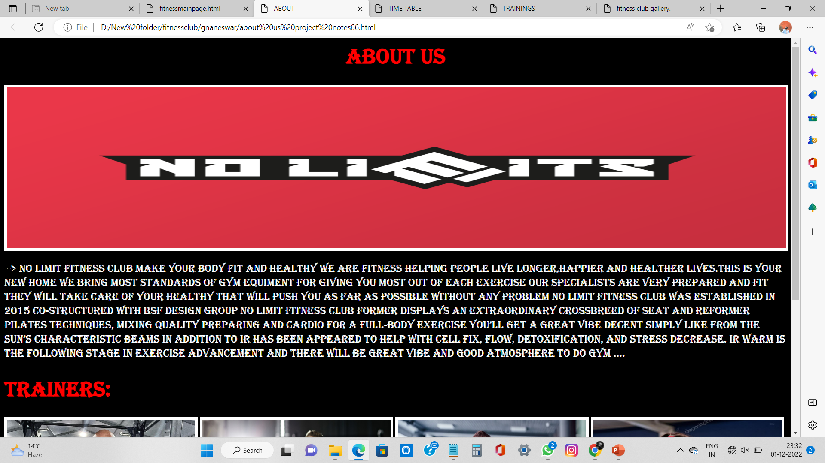
ABOUT US OUTPUT

Slide 49
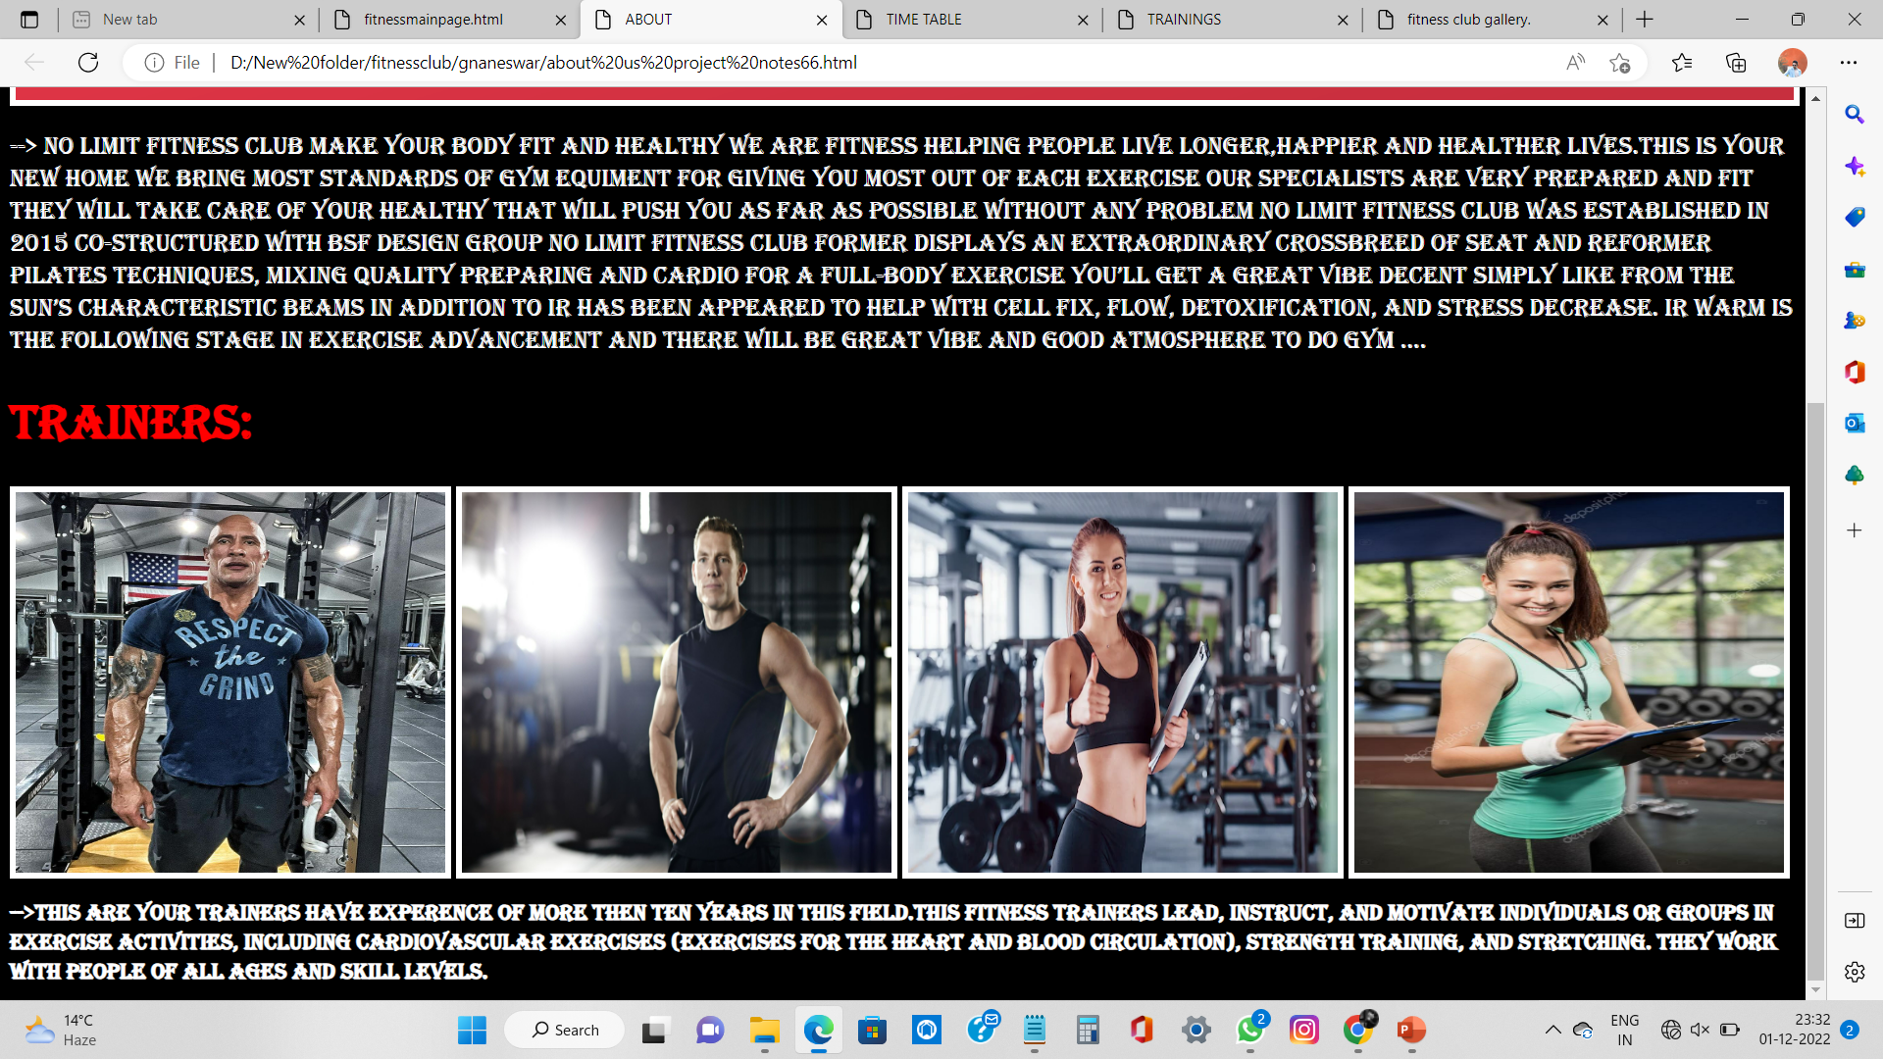

Slide 50
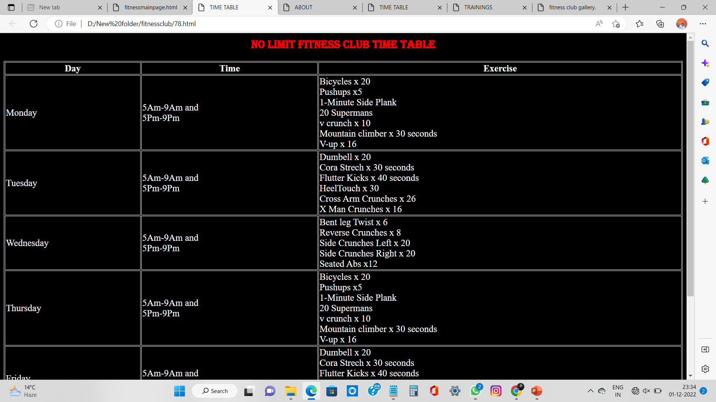
TIME TABLE OUTPUT

Slide 51
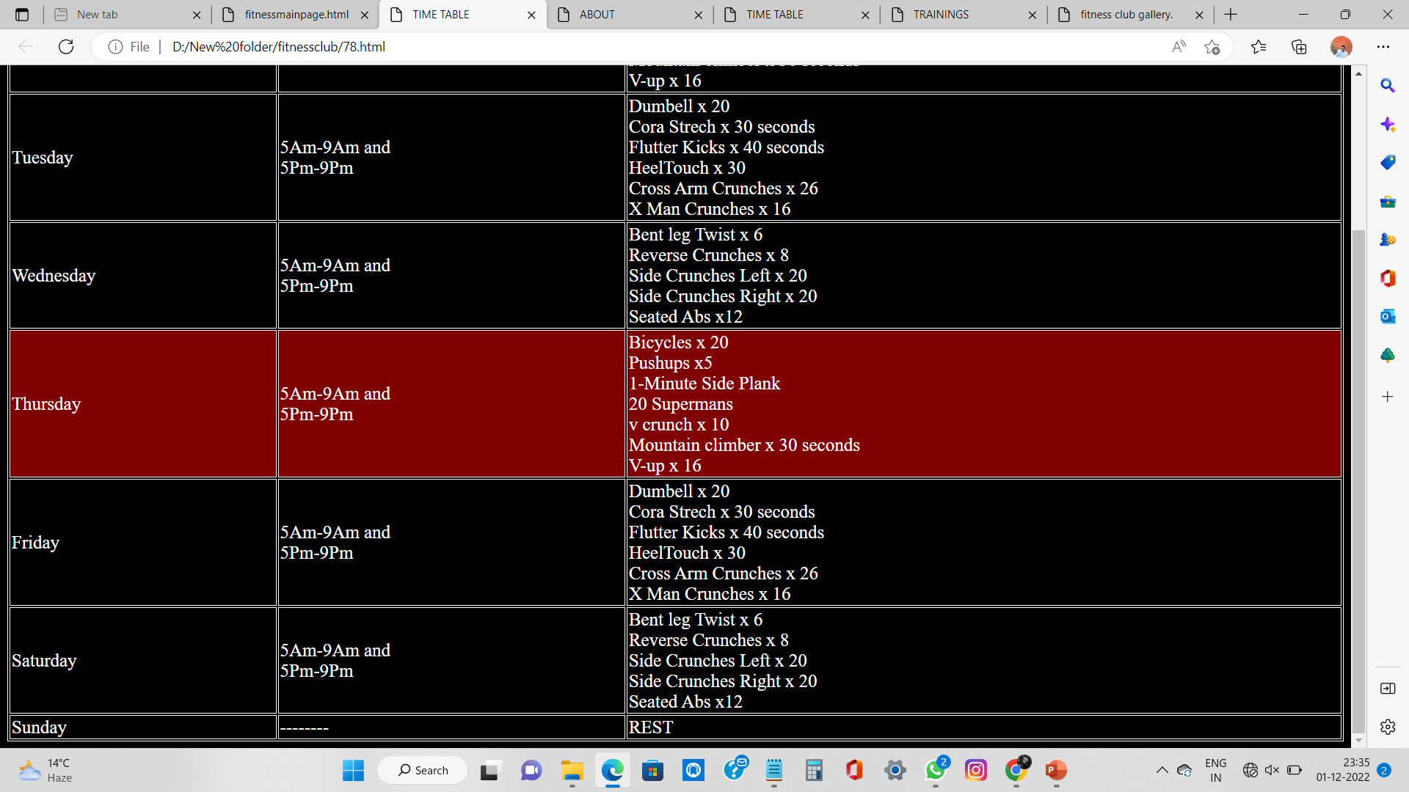

Slide 52
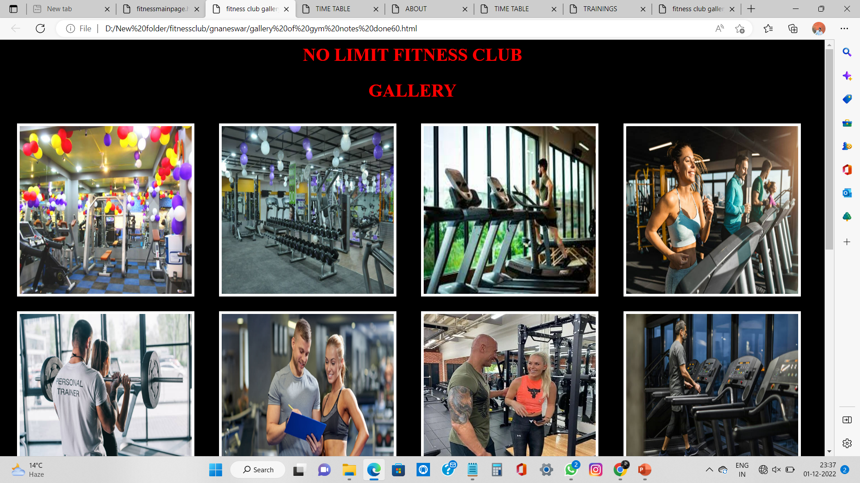
GALLERY OUTPUT

Slide 53
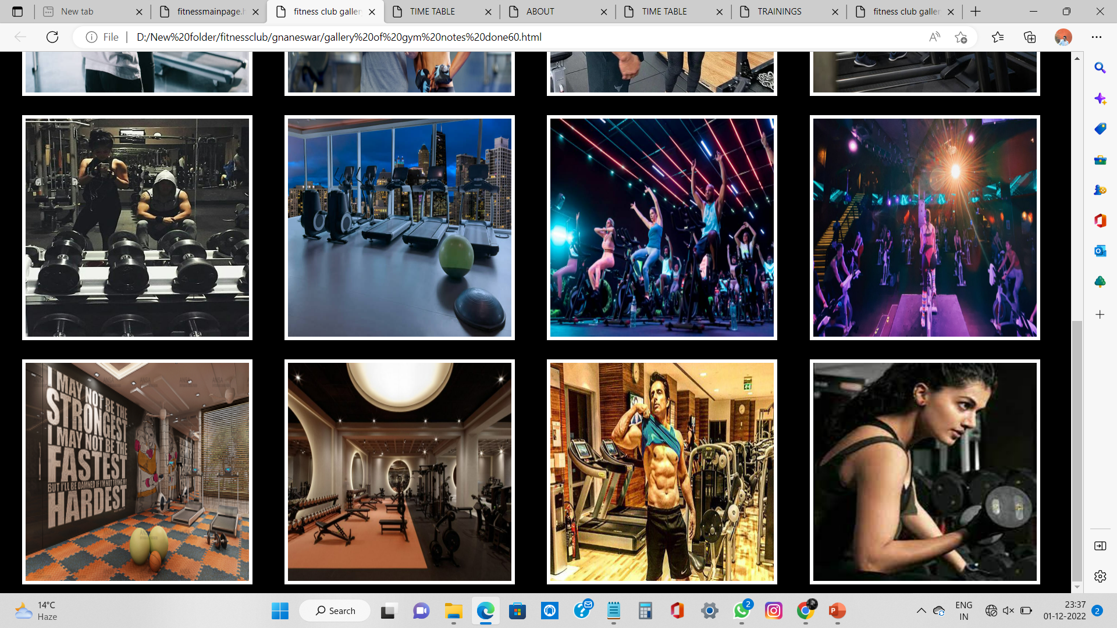

Slide 54
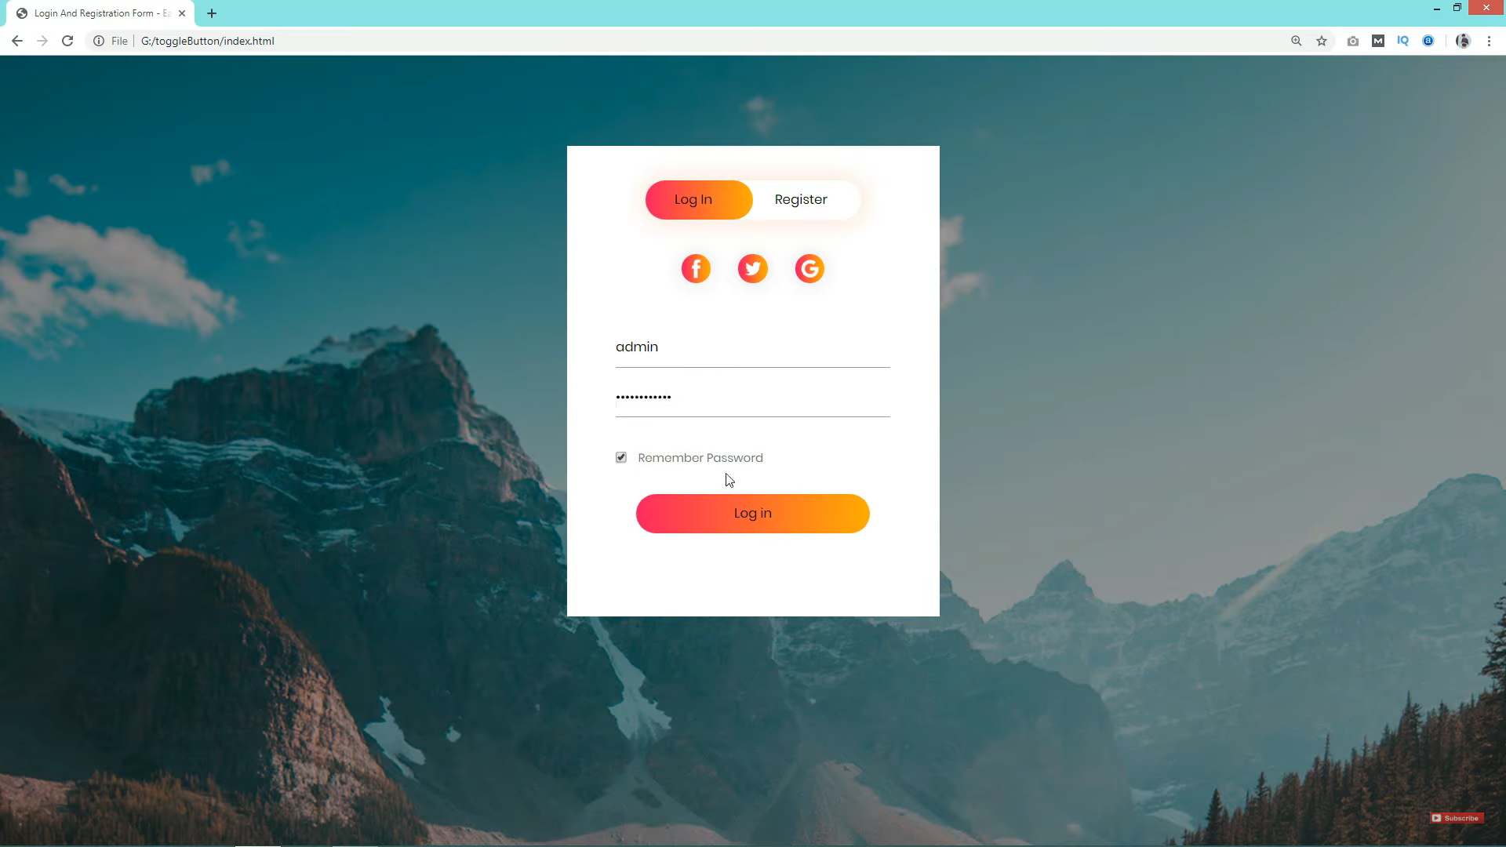
LOGIN/SIGN UP OUTPUT

Slide 55
CONCLUSION
We hope and we wish that this document will help you to understand about our minimalist but attractive project as I had tried something different from usual. We had used HTML/CSS/JAVA SCRIPT for logical…

